Slide 1
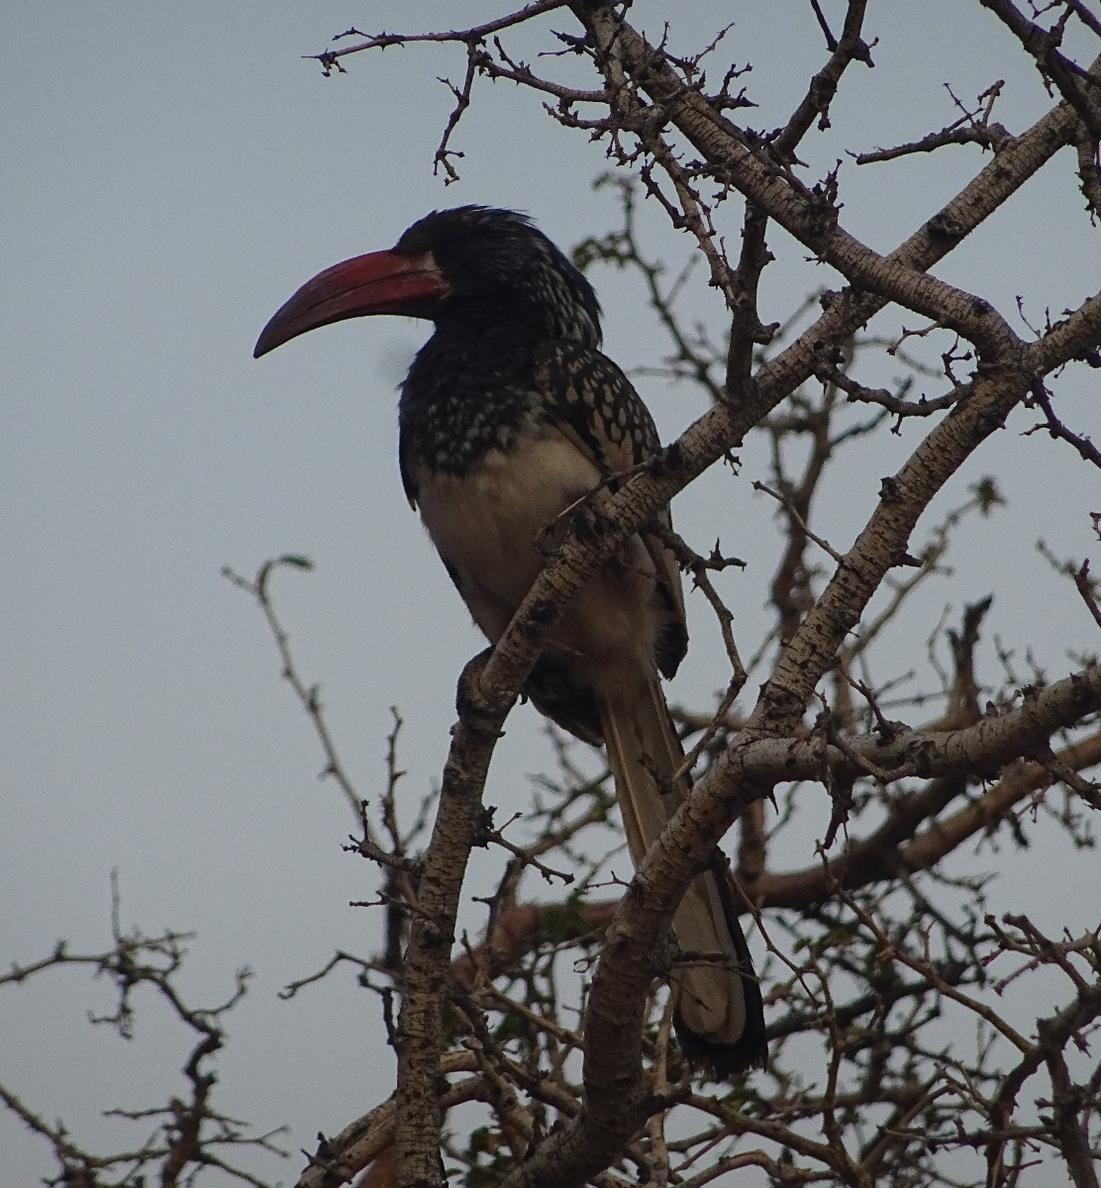
Age based matrix models

Slide 2
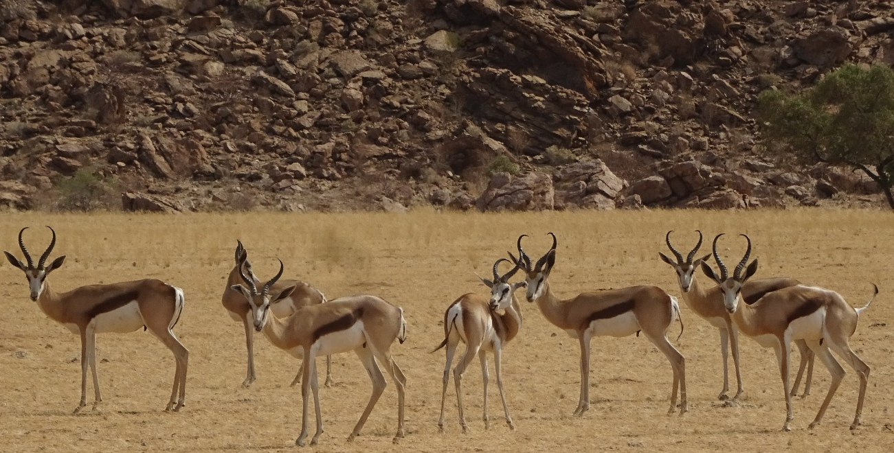
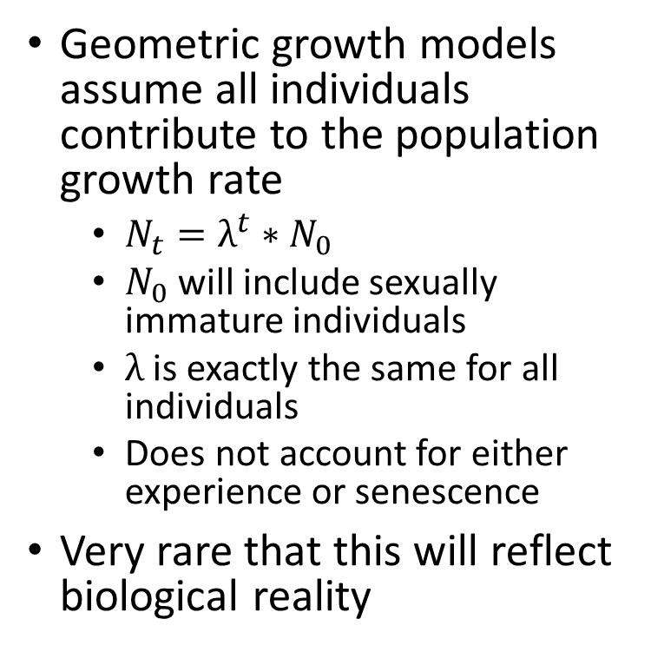
The problem with geometric growth models
Geometric growth models assume all individuals contribute to the population growth rate
$N_{t}=λ^{t}∗N_{0}$
$N_{0}$ will include sexually immature individuals
$λ$ is exactly the same for all individuals
Does not account for either experience or senescence
Very rare that this will reflect biological reality

Slide 3
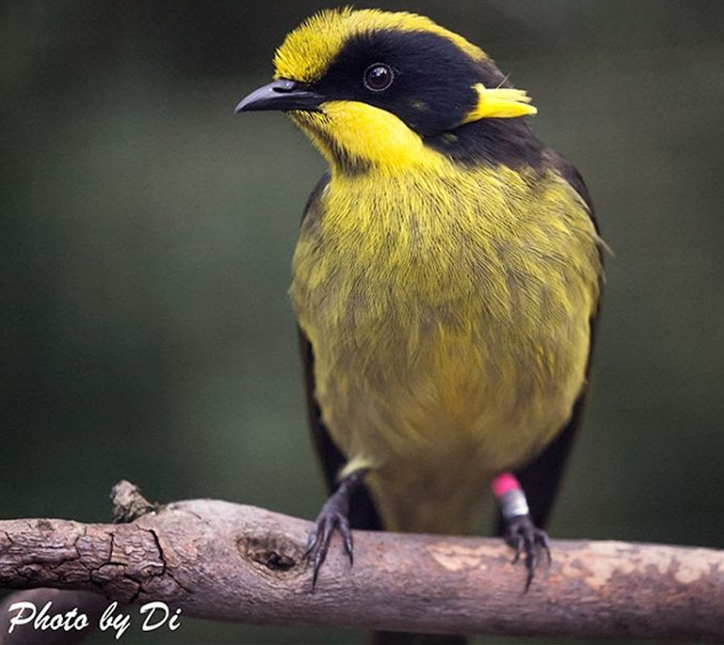
Motivating example; Helmeted honeyeater
Helmeted honeyeater
Lichenostomus melanops cassidix
Critically endangered
Present in 1 reserve in Australia
Breed when 1 year old
From July to March
Can live up to 9 years old
But we’ll limit to 2 year olds
So 3 years of life (0, 1, 2)

Slide 4
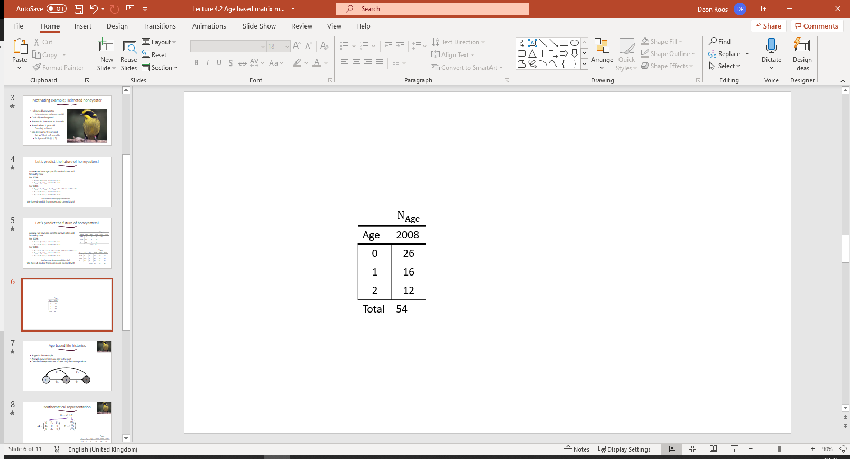
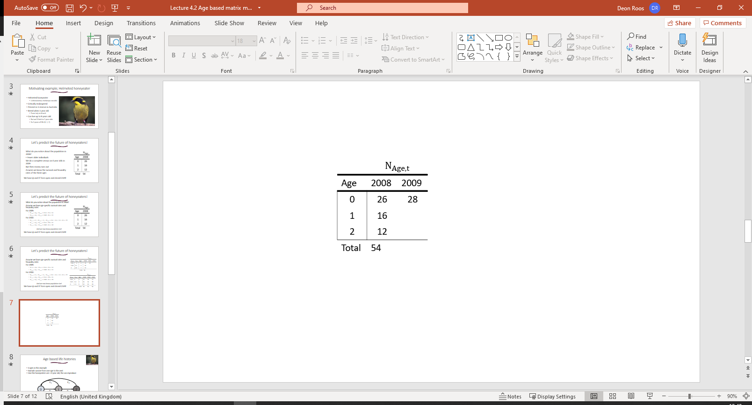
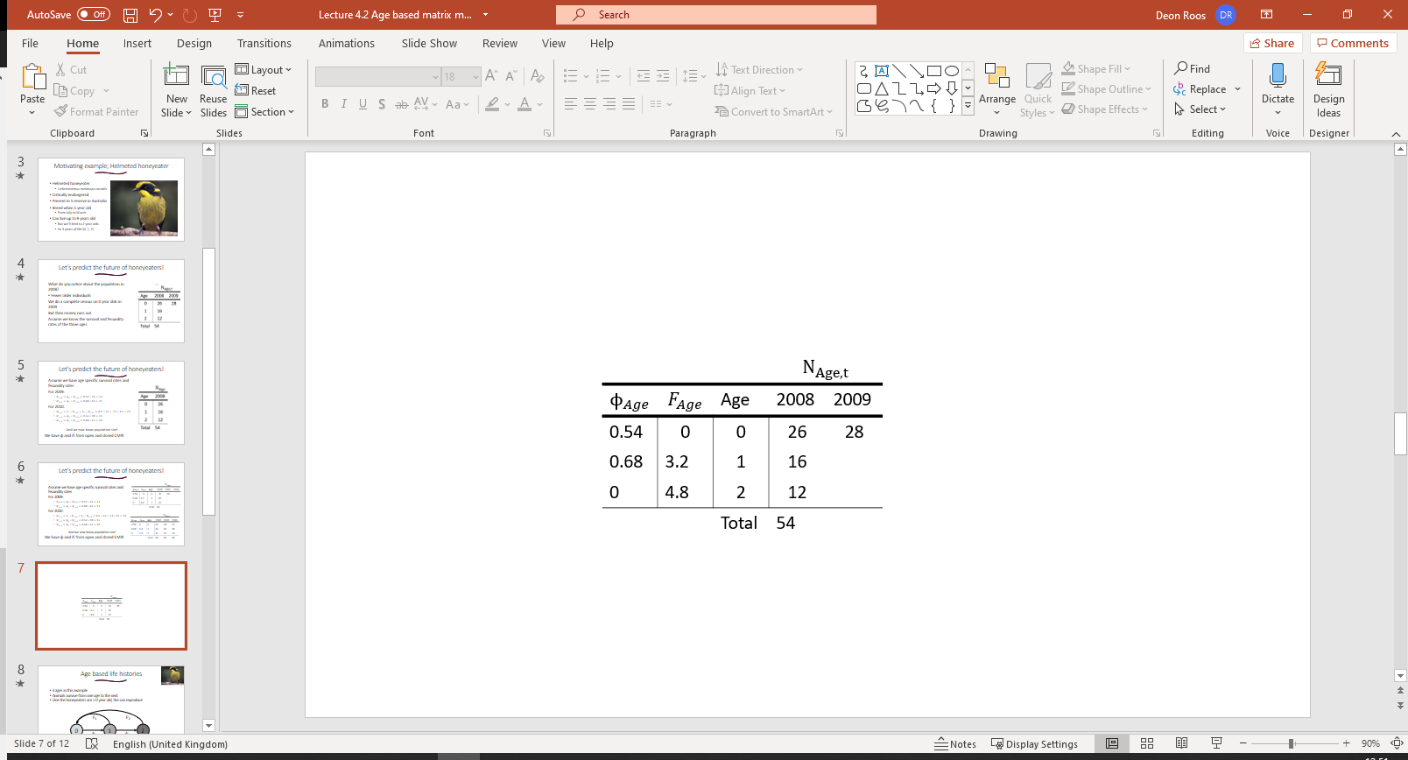
Let’s predict the future of honeyeaters!
What do you notice about the population in 2008?
Fewer older individuals
We do a complete census on 0 year olds in 2009
But then money runs out
Assume we know the survival and fecundity rates of the three ages
What will our population size be in 2009?

Slide 5
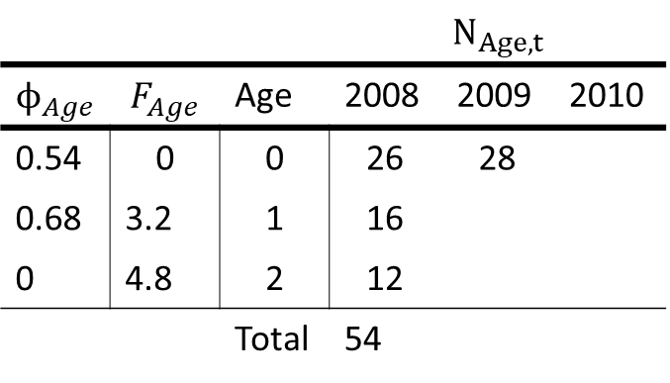
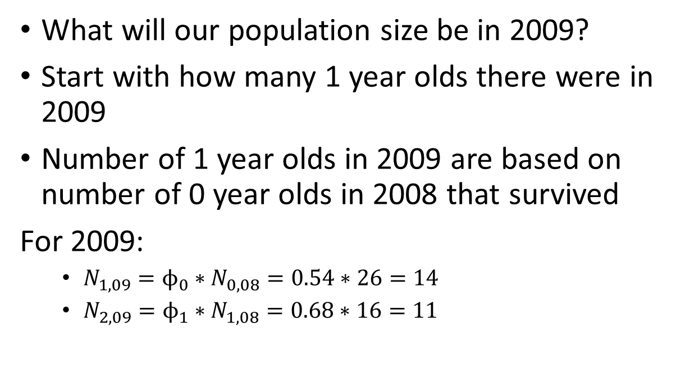
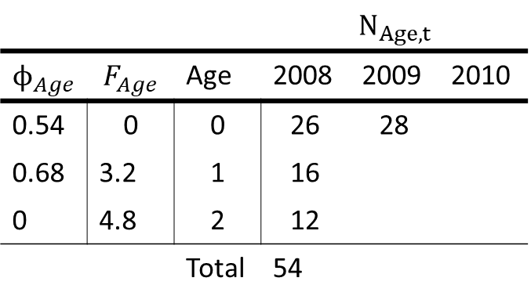
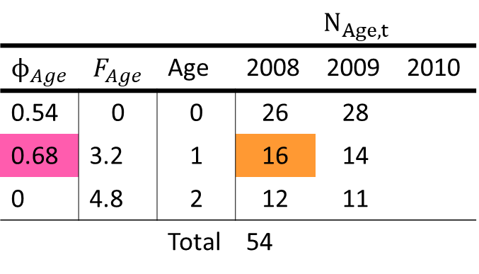
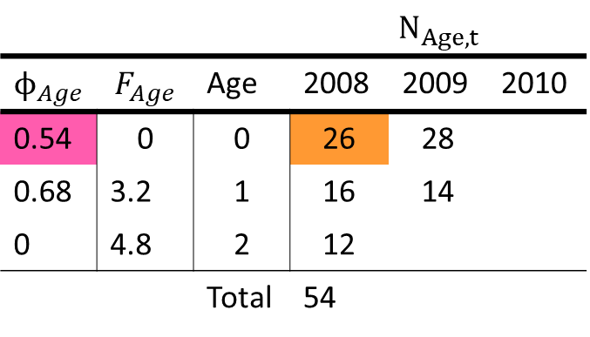
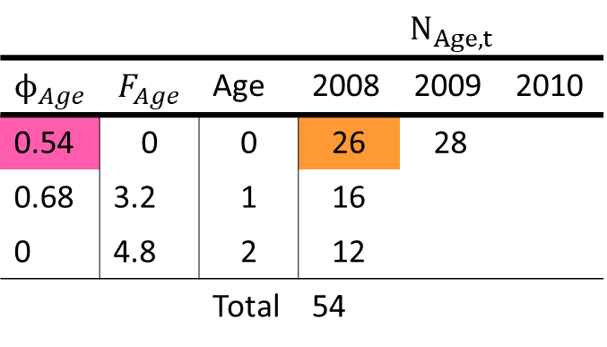
Let’s predict the future of honeyeaters!
What will our population size be in 2009?
Start with how many 1 year olds there were in 2009
Number of 1 year olds in 2009 are based on number of 0 year olds in 2008 that survived
For 2009:
$N_{1,09}=ϕ_{0}∗N_{0,08}=0.54∗26=14$
$N_{2,09}=ϕ_{1}∗N_{1,08}=0.68∗16=11$
 |  |  | $$N_{Age,t}$$
$$ϕ_{Age}$$ | $$F_{Age}$$ | Age | 2008 | 2009 | 2010
0.54 | 0 | 0 | 26 | 28
0.68 | 3.2 | 1 | 16
0 | 4.8 | 2 | 12
 |  | Total | 54
 |  |  | $$N_{Age,t}$$
$$ϕ_{Age}$$ | $$F_{Age}$$ | Age | 2008 | 2009 | 2010
0.54 | 0 | 0 | 26 | 28
0.68 | 3.2 | 1 | 16
0 | 4.8 | 2 | 12
 |  | Total | 54
 |  |  | $$N_{Age,t}$$
$$ϕ_{Age}$$ | $$F_{Age}$$ | Age | 2008 | 2009 | 2010
0.54 | 0 | 0 | 26 | 28
0.68 | 3.2 | 1 | 16 | 14
0 | 4.8 | 2 | 12
 |  | Total | 54
 |  |  | $$N_{Age,t}$$
$$ϕ_{Age}$$ | $$F_{Age}$$ | Age | 2008 | 2009 | 2010
0.54 | 0 | 0 | 26 | 28
0.68 | 3.2 | 1 | 16 | 14
0 | 4.8 | 2 | 12 | 11
 |  | Total | 54
 |  |  | $$N_{Age,t}$$
$$ϕ_{Age}$$ | $$F_{Age}$$ | Age | 2008 | 2009 | 2010
0.54 | 0 | 0 | 26 | 28
0.68 | 3.2 | 1 | 16
0 | 4.8 | 2 | 12
 |  | Total | 54

Slide 6
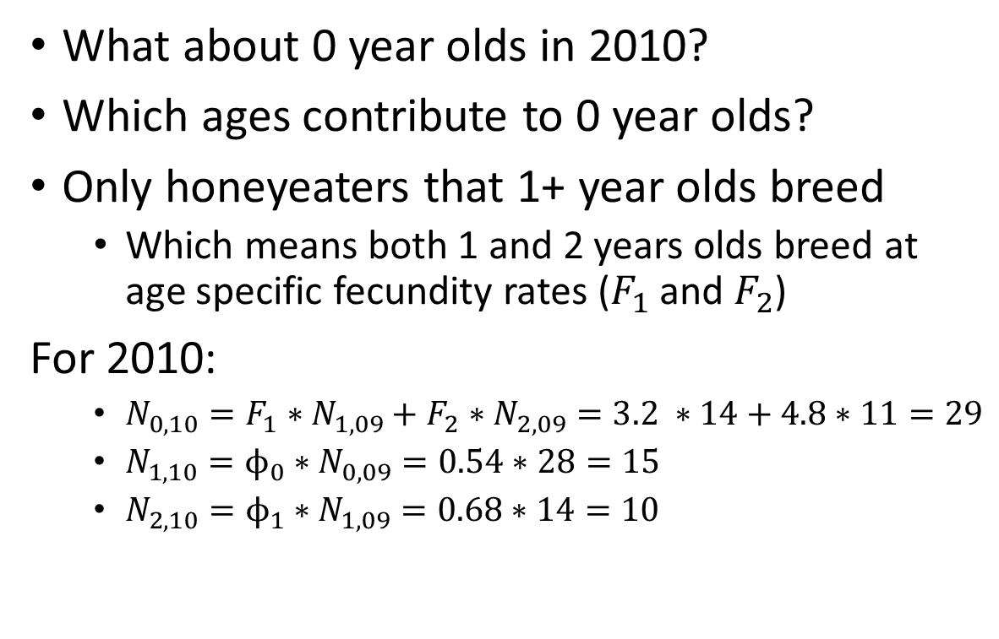
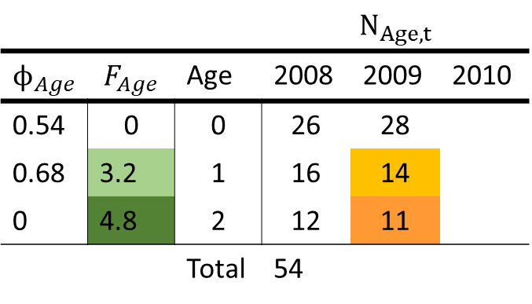
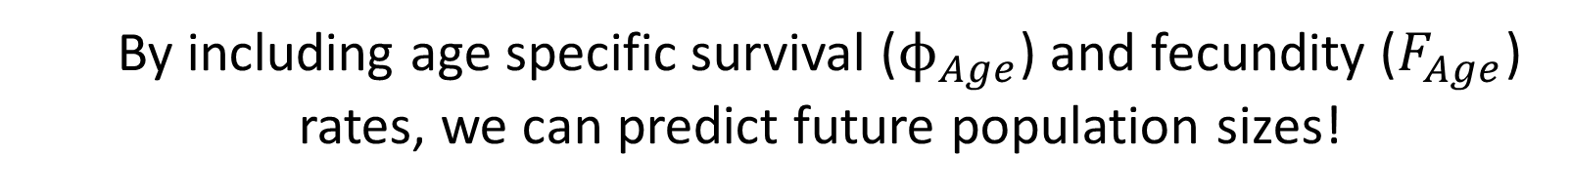
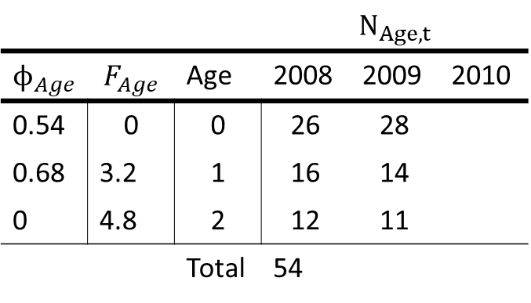
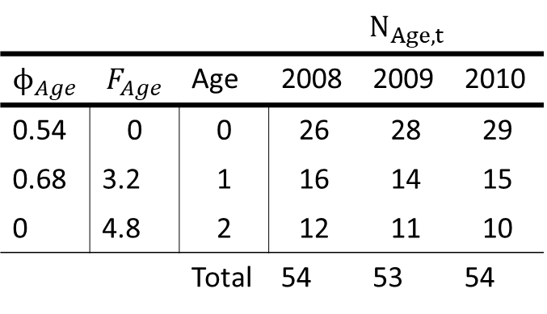
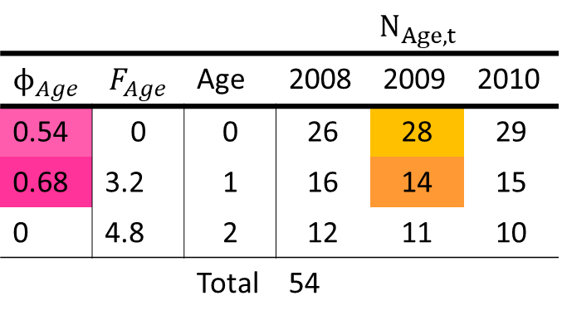
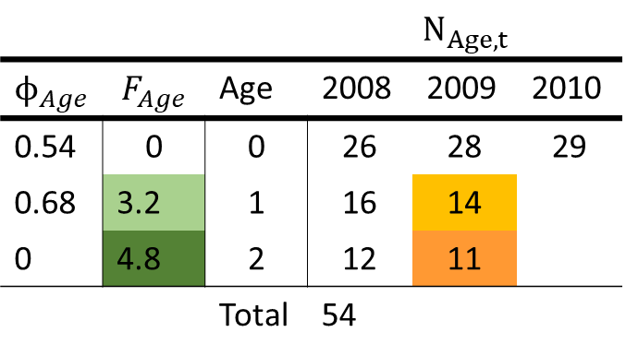
Let’s predict the future of honeyeaters!
What about 0 year olds in 2010?
Which ages contribute to 0 year olds?
Only honeyeaters that 1+ year olds breed
Which means both 1 and 2 years olds breed at age specific fecundity rates ($F_{1}$ and $F_{2}$)
For 2010:
$N_{0,10}=F_{1}∗N_{1,09}+F_{2}∗N_{2,09}=3.2 ∗14+4.8∗11=29$
$N_{1,10}=ϕ_{0}∗N_{0,09}=0.54∗28=15$
$N_{2,10}=ϕ_{1}∗N_{1,09}=0.68∗14=10$
 |  |  | $$N_{Age,t}$$
$$ϕ_{Age}$$ | $$F_{Age}$$ | Age | 2008 | 2009 | 2010
0.54 | 0 | 0 | 26 | 28 | 29
0.68 | 3.2 | 1 | 16 | 14 | 15
0 | 4.8 | 2 | 12 | 11 | 10
 |  | Total | 54 | 53 | 54
 |  |  | $$N_{Age,t}$$
$$ϕ_{Age}$$ | $$F_{Age}$$ | Age | 2008 | 2009 | 2010
0.54 | 0 | 0 | 26 | 28 | 29
0.68 | 3.2 | 1 | 16 | 14
0 | 4.8 | 2 | 12 | 11
 |  | Total | 54
 |  |  | $$N_{Age,t}$$
$$ϕ_{Age}$$ | $$F_{Age}$$ | Age | 2008 | 2009 | 2010
0.54 | 0 | 0 | 26 | 28 | 29
0.68 | 3.2 | 1 | 16 | 14 | 15
0 | 4.8 | 2 | 12 | 11 | 10
 |  | Total | 54
 |  |  | $$N_{Age,t}$$
$$ϕ_{Age}$$ | $$F_{Age}$$ | Age | 2008 | 2009 | 2010
0.54 | 0 | 0 | 26 | 28
0.68 | 3.2 | 1 | 16 | 14
0 | 4.8 | 2 | 12 | 11
 |  | Total | 54
 |  |  | $$N_{Age,t}$$
$$ϕ_{Age}$$ | $$F_{Age}$$ | Age | 2008 | 2009 | 2010
0.54 | 0 | 0 | 26 | 28
0.68 | 3.2 | 1 | 16 | 14
0 | 4.8 | 2 | 12 | 11
 |  | Total | 54
By including age specific survival ($ϕ_{Age}$) and fecundity ($F_{Age}$) rates, we can predict future population sizes!

Slide 7
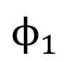
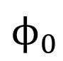
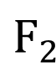
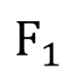
To do this, we exploited age based life histories
3 ages in this example (0, 1 and 2 year olds)
Young animals “contribute” to next age population by surviving
Reproductive animals “contribute” to 0 year old population by reproducing
$$F_{1}$$
$$F_{2}$$
0
1
2
$$ϕ_{0}$$
$$ϕ_{1}$$

Slide 8
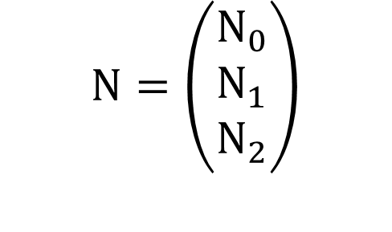
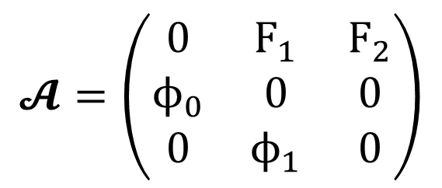
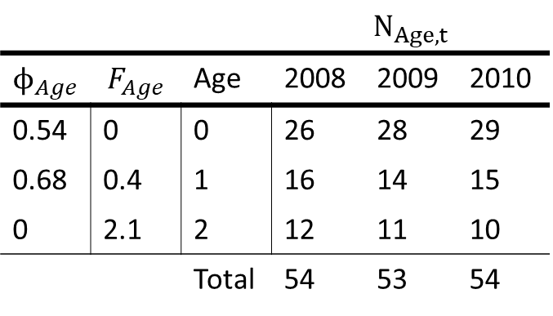
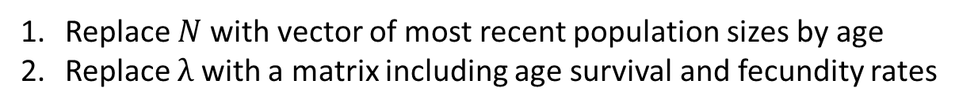
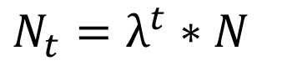
Mathematical representation
$N_{t}=λ^{t}∗$ $N$
 |  |  | $$N_{Age,t}$$
$$ϕ_{Age}$$ | $$F_{Age}$$ | Age | 2008 | 2009 | 2010
0.54 | 0 | 0 | 26 | 28 | 29
0.68 | 0.4 | 1 | 16 | 14 | 15
0 | 2.1 | 2 | 12 | 11 | 10
 |  | Total | 54 | 53 | 54
$$𝓐=\left(\begin{matrix}0 & F_{1} & F_{2} \\ ϕ_{0} & 0 & 0 \\ 0 & ϕ_{1} & 0\end{matrix}\right)$$
$$N=\left(\begin{matrix}N_{0} \\ N_{1} \\ N_{2}\end{matrix}\right)$$
Replace $N$with vector of most recent population sizes by age
Replace $λ$ with a matrix including age survival and fecundity rates

Slide 9
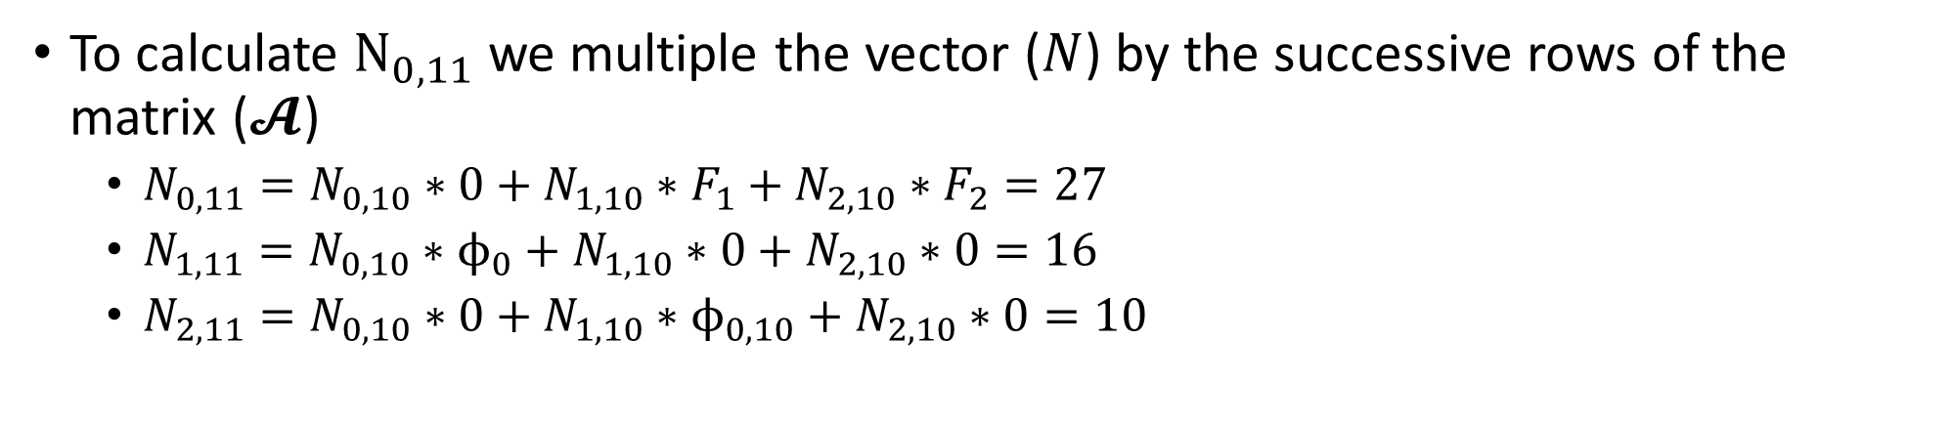
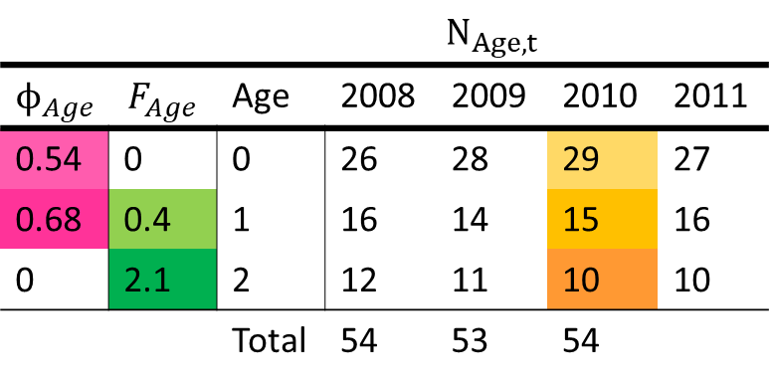

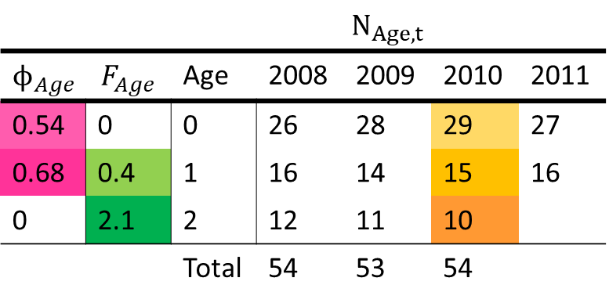

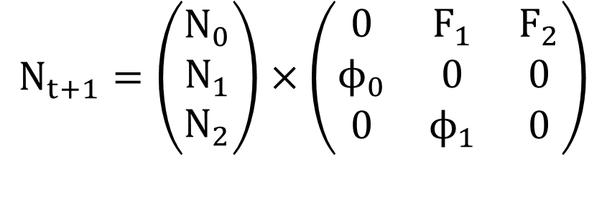
Using matrix models to calculate 2011
 |  |  | $$N_{Age,t}$$
$$ϕ_{Age}$$ | $$F_{Age}$$ | Age | 2008 | 2009 | 2010 | 2011
0.54 | 0 | 0 | 26 | 28 | 29 | 27
0.68 | 0.4 | 1 | 16 | 14 | 15 | 16
0 | 2.1 | 2 | 12 | 11 | 10
 |  | Total | 54 | 53 | 54
 |  |  | $$N_{Age,t}$$
$$ϕ_{Age}$$ | $$F_{Age}$$ | Age | 2008 | 2009 | 2010 | 2011
0.54 | 0 | 0 | 26 | 28 | 29
0.68 | 0.4 | 1 | 16 | 14 | 15
0 | 2.1 | 2 | 12 | 11 | 10
 |  | Total | 54 | 53 | 54
 |  |  | $$N_{Age,t}$$
$$ϕ_{Age}$$ | $$F_{Age}$$ | Age | 2008 | 2009 | 2010 | 2011
0.54 | 0 | 0 | 26 | 28 | 29 | 27
0.68 | 0.4 | 1 | 16 | 14 | 15
0 | 2.1 | 2 | 12 | 11 | 10
 |  | Total | 54 | 53 | 54
 |  |  | $$N_{Age,t}$$
$$ϕ_{Age}$$ | $$F_{Age}$$ | Age | 2008 | 2009 | 2010 | 2011
0.54 | 0 | 0 | 26 | 28 | 29 | 27
0.68 | 0.4 | 1 | 16 | 14 | 15 | 16
0 | 2.1 | 2 | 12 | 11 | 10 | 10
 |  | Total | 54 | 53 | 54
$$N_{t+1}=\left(\begin{matrix}N_{0} \\ N_{1} \\ N_{2}\end{matrix}\right)×\left(\begin{matrix}0 & F_{1} & F_{2} \\ ϕ_{0} & 0 & 0 \\ 0 & ϕ_{1} & 0\end{matrix}\right)$$
To calculate $N_{0,11}$ we multiple the vector ($N$) by the successive rows of the matrix ($𝓐$)
$N_{0,11}=N_{0,10}∗0+N_{1,10}∗F_{1}+N_{2,10}∗F_{2}=27$
$N_{1,11}=N_{0,10}∗ϕ_{0}+N_{1,10}∗0+N_{2,10}∗0=16$
$N_{2,11}=N_{0,10}∗0+N_{1,10}∗ϕ_{0,10}+N_{2,10}∗0=10$

Slide 10
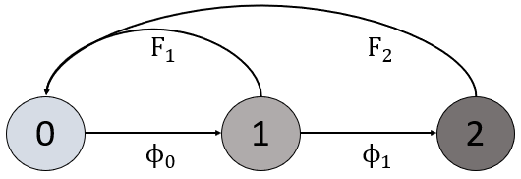

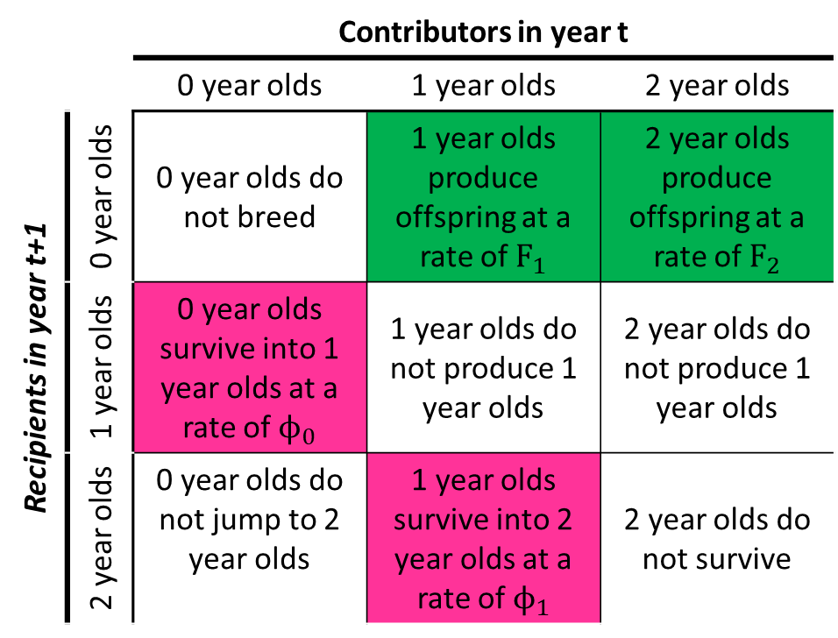
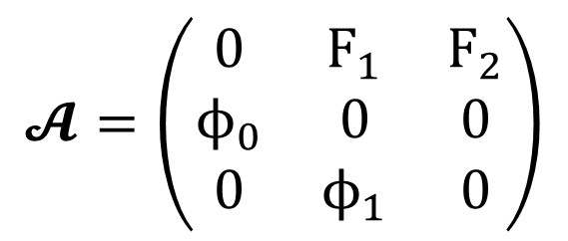
How to read the matrix $𝓐$
 |  | Contributors in year t
 |  | 0 year olds | 1 year olds | 2 year olds
Recipients in year t+1 | 0 year olds | 0 year olds do not breed | 1 year olds produce offspring at a rate of $F_{1}$ | 2 year olds produce offspring at a rate of $F_{2}$
 | 1 year olds | 0 year olds survive into 1 year olds at a rate of $ϕ_{0}$ | 1 year olds do not produce 1 year olds | 2 year olds do not produce 1 year olds
 | 2 year olds | 0 year olds do not jump to 2 year olds | 1 year olds survive into 2 year olds at a rate of $ϕ_{1}$ | 2 year olds do not survive
$$𝓐=\left(\begin{matrix}0 & F_{1} & F_{2} \\ ϕ_{0} & 0 & 0 \\ 0 & ϕ_{1} & 0\end{matrix}\right)$$

Slide 11
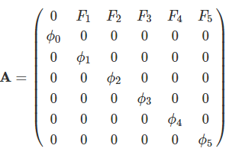
What about for older animals? E.g. Species which live for 6 years

Slide 12
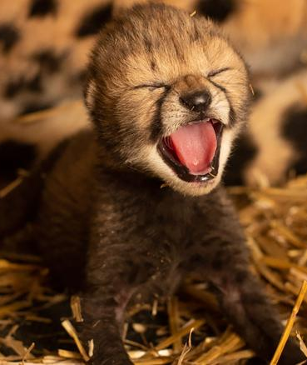
Breeding season and data collection timing
When we do our data collection is important information to take into account
If we do collection before breeding
Then we do not see any new borns
The new borns must survive for ca. one year
Then we see them
If we do collection after breeding, then for new borns to be surveyed the following year
The breeders must survive for ca. one year before being able to breed

Slide 13
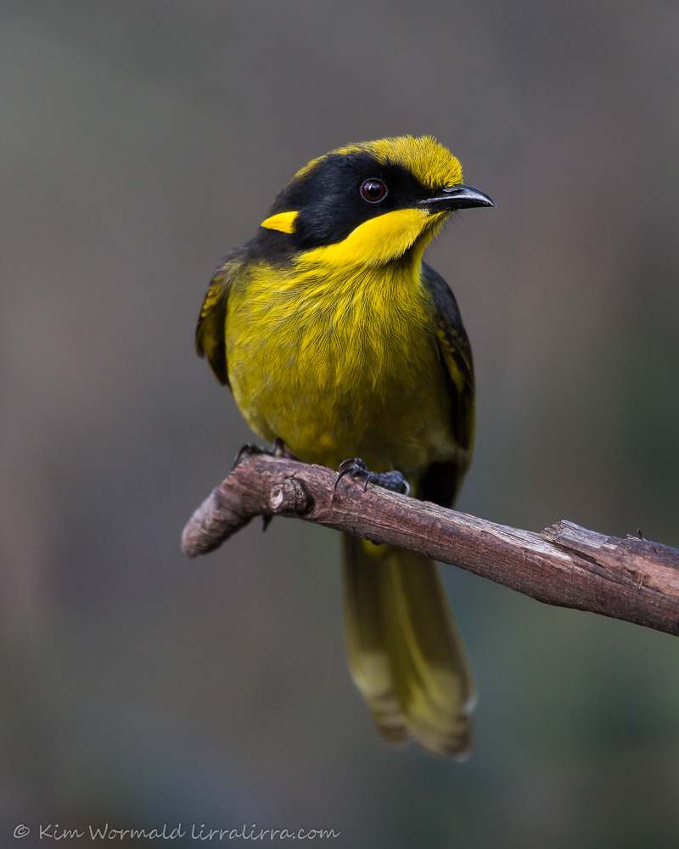
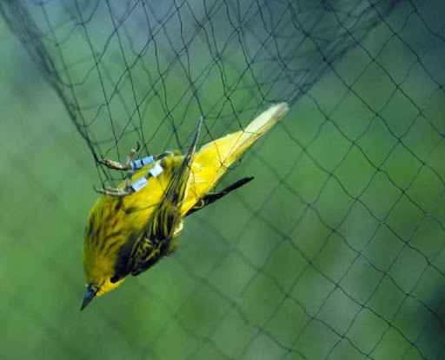
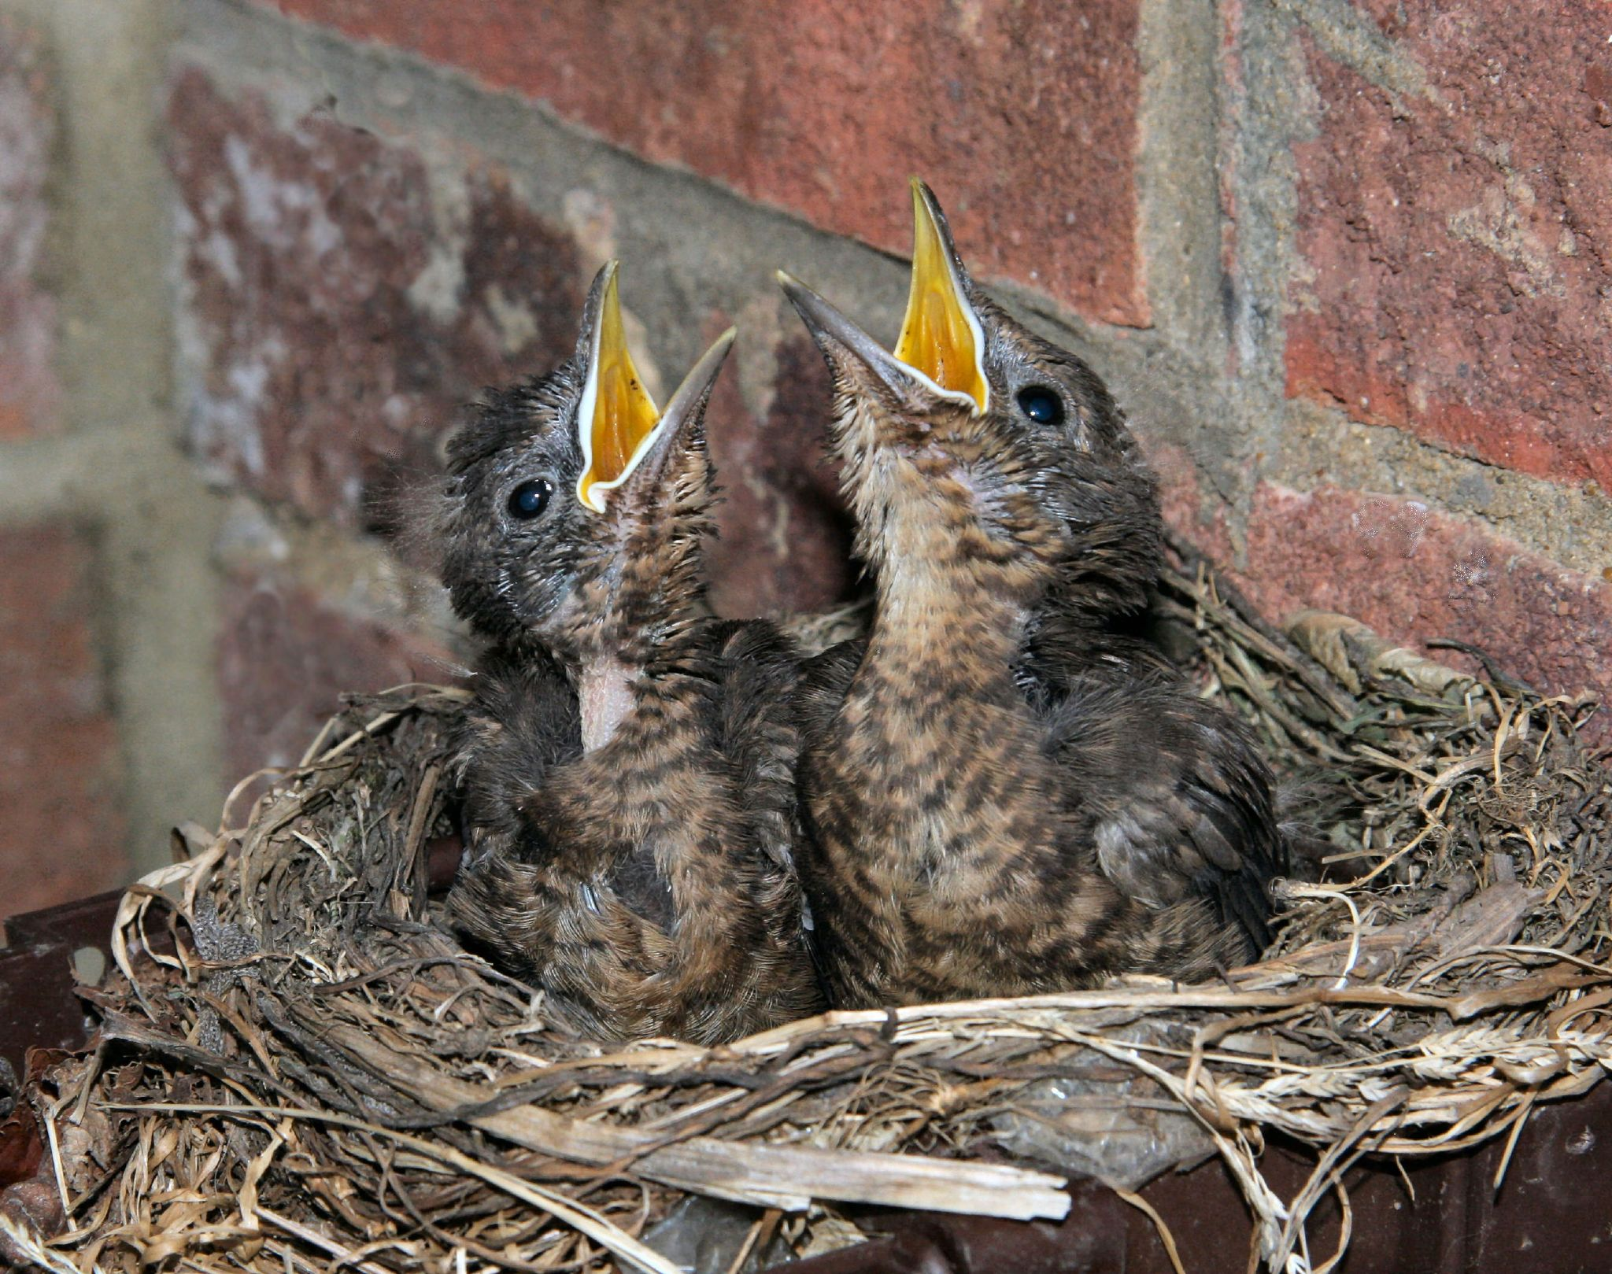
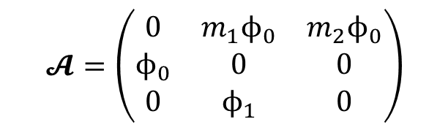
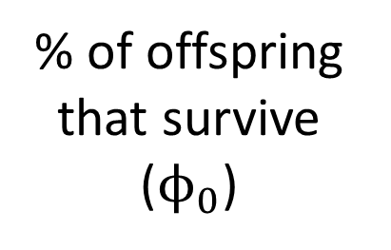
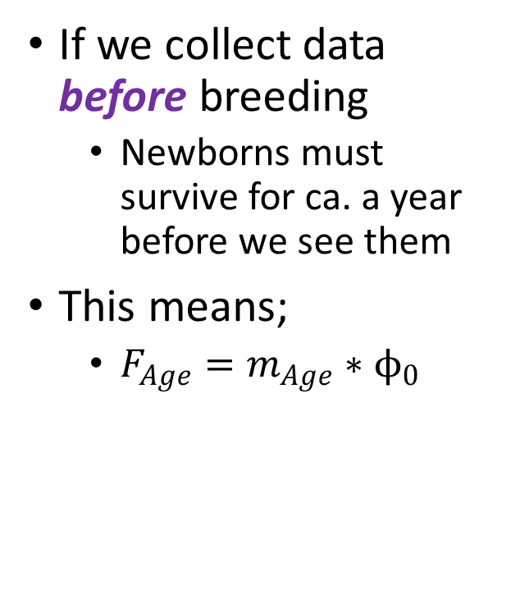
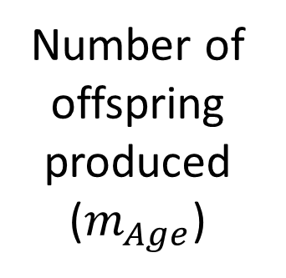
Pre-breeding data collection
If we collect data before breeding
Newborns must survive for ca. a year before we see them
This means;
$F_{Age}=m_{Age}∗ϕ_{0}$
0 year old survives until April
Survey in June
Breed July-March
Number of offspring produced ($m_{Age}$)
$$𝓐=\left(\begin{matrix}0 & {m_{1}ϕ}_{0} & {m_{2}ϕ}_{0} \\ ϕ_{0} & 0 & 0 \\ 0 & ϕ_{1} & 0\end{matrix}\right)$$
% of offspring that survive ($ϕ_{0}$)

Slide 14
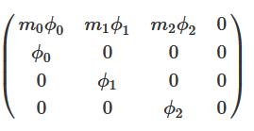
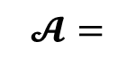
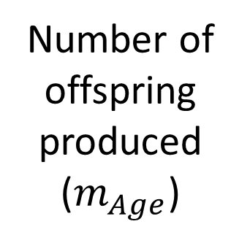
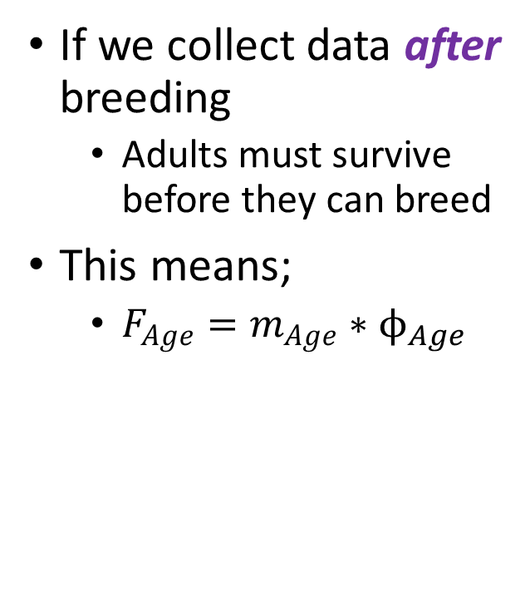
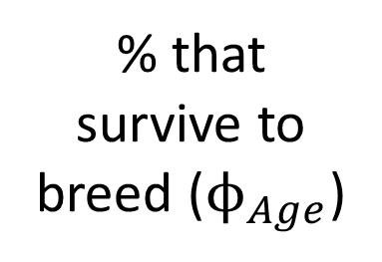
Post breeding data collection
If we collect data after breeding
Adults must survive before they can breed
This means;
$F_{Age}=m_{Age}∗ϕ_{Age}$
Must survive to breed
Breed July-March
Survey in April
Number of offspring produced ($m_{Age}$)
$$𝓐=$$
% that survive to breed ($ϕ_{Age}$)

Slide 15




Refining $F_{Age}$
We have refined $F_{Age}$to take breeding and survey times into account
$F_{Age}=m_{Age}∗ϕ_{0}$
But there are some more refinements
Do both sexes produce offspring?
No, only females.
$F_{Age}=m_{Age}∗ϕ_{0}∗ σ$
Where;
$σ$ is the proportion of females (i.e. sex ratio)
$F_{Age}$ is then the number of offspring per breeding female
$$𝓐=\left(\begin{matrix}0 & {m_{1}ϕ}_{0}σ & {m_{2}ϕ}_{0}σ \\ ϕ_{0} & 0 & 0 \\ 0 & ϕ_{1} & 0\end{matrix}\right)$$

Slide 16



tl;dr
 |  |  | $$N_{Age,t}$$
$$ϕ_{Age}$$ | $$F_{Age}$$ | Age | 2008 | 2009 | 2010 | 2011
0.54 | 0 | 0 | 26 | 28 | 29 | 27
0.68 | 0.4 | 1 | 16 | 14 | 15 | 16
0 | 2.1 | 2 | 12 | 11 | 10 | 10
 |  | Total | 54 | 53 | 54 | 53
 |  | Contributors in year t
 |  | 0 year olds | 1 year olds | 2 year olds
Recipients in year t+1 | 0 year olds | 0 year olds do not breed | 1 year olds produce offspring at a rate of $F_{1}$ | 2 year olds produce offspring at a rate of $F_{2}$
 | 1 year olds | 0 year olds survive into 1 year olds at a rate of $ϕ_{0}$ | 1 year olds do not produce 1 year olds | 2 year olds do not produce 1 year olds
 | 2 year olds | 0 year olds do not jump to 2 year olds | 1 year olds survive into 2 year olds at a rate of $ϕ_{1}$ | 2 year olds do not survive
$$N_{t+1}=\left(\begin{matrix}N_{0} \\ N_{1} \\ N_{2}\end{matrix}\right)×\left(\begin{matrix}0 & F_{1} & F_{2} \\ ϕ_{0} & 0 & 0 \\ 0 & ϕ_{1} & 0\end{matrix}\right)$$

